Slide 1
Red Zuma Project June 01, 2025
MGT 598 – Project Management Section 1
TEAM 7 Afia Mehjabin, Meet Patel, Nikitha Gokulapati, Sripriya Battu, Vishu Vardhan Ummadi

Slide 2
Agenda
Scope Document
Project Cost
Project NPV
Activity on Node - AON
Project Schedule
Earned Value Management - EVM
Communication Plan
Risk Assessment/ Risk Response Matrix
Suggestions
Summary

Slide 3
Project Objective & Description
The objective of the project is that to plan, develop, and test a new model of razor scooters called the Red Zuma. The project is intended to start on January 2, 2015, with the goal of completing it January 17, 2016. The goal is to have the scooters be ready for the major trade show in Las Vegas on January 22, 2016. The scooters are made with at least 25% recyclable materials weighing less than 95 pounds. The scooters have a battery life of more than 30 hours and comes in 4 different colors. With the surge of racing scooters, the Red Zuma is believed to strive in the market. The predicted cost of the project is $1,379,400 USD.

Slide 4
Justification
According to the ARC’s Sales Team, there is a surge in the market demand for high-performing racing scooters like the Red Zuma. The new product initiative along with the current consumer trends also positions ARC in the Extreme Sports Market aspiring to eventually feature on such competitive platforms, such as X-Games. Despite being a small sized company, ARC operates on limited resources and must mindfully prioritize projects that focus on high market impact and brand growth.
KEY BENEFITS OF PURCHASING RED ZUMA ARE:
Revenue Potential: Early bird entry into the racing scooter segment can create an increase in sales and market share
Brand Visibility: A successful launch at the trade shows will enhance brand visibility and strengthen ARC’s position as an innovator
Market Diversification: The product Red Zuma expands ARC’s portfolio, reducing dependency on the existing product lines and create demand among the younger performance-driven audience
Strategic Timing: The deadline – January 17, 2016, aligns with the trade show, providing clear time constraint that reinforces urgency and purpose for the project

Slide 5
Deliverables
A new and fast razor scooter made for racing.
There will be 4 available colors for customers to choose from.
It will be less than 95 pounds for better mobility.
It includes recyclable materials to appeal to the environmentally conscious crowd.
Battery life of more than 30 hours for longer usage.
3 out of 4 satisfaction score based on Market Research consumer test trials
Safety Compliances are met to the highest standards.
The scooter would have been piloted and tested for over 90 days (about 3 months) before it was released to the public.
Product launch and marketing strategies to effectively advertise the scooter.

Slide 6
Milestones
2 Jan. 2015
Project Kickoff and Team Alignment
1 Mar. 2015
Design Completion and Concept Approval
15 May 2015
Prototype Development Completion
1 June 2015
Market Testing initiated in EMEA region (e.g., Spain)
31 Aug. 2015
Market Testing Evaluation
10 Sep. 2015
EU Safety Compliance Certification
1 Oct. 2015
Manufacturing Plan and Production Setup
1 Dec. 2015
Final Product Review and Approval for Launch
17 Jan. 2016
Launch at Trade Show (Product Release)
3

Slide 7
Technical Requirements
Battery must last more than 30 hours
Scooter must weigh under 95 pounds
At least 25% of materials must be recyclable
Offered in four standard colors: Black, White, Red, Blue
Must meet EU safety standards for launch in Spain
Must score at least 3 out of 4 in market research consumer trials

Slide 8
Limits and Exclusions
Timeframe Constraint - The project must be completed by January 17, 2016, to meet the trade show deadline. No extensions are planned.
Resource Availability - The project is limited to the personnel and equipment available within ARC unless explicitly approved for augmentation.
Budget Limitations - The budget is fixed, with a maximum of $50,000 available in management reserves for contingency use.
Technology Constraints - Only existing, proven manufacturing and testing technologies will be used; new or experimental technologies are out of scope.
Prototype Focus - The project will produce and test functional prototypes only. No mass manufacturing or assembly-line setup is included.
Personalization – Few choices on customizing the Red Zuma. Apart from choosing colors, there aren't many options.
Location – Tested in Spain for use in the Las Vegas Games. Company based in the US.

Slide 9
Acceptance Criteria
3
Red Zuma razor scooter passes the requirements to enter as racing scooters for the X-Game Events.
Product launched on schedule and in time for X-Game Events (By January 17, 2016).
Project is not over budget.
Employees are not over-worked, giving them the appropriate weekends and holidays off.
After evaluation and feedback on Market Research consumer test trials, there should be a satisfactory score of 3 out of 4.

Slide 10
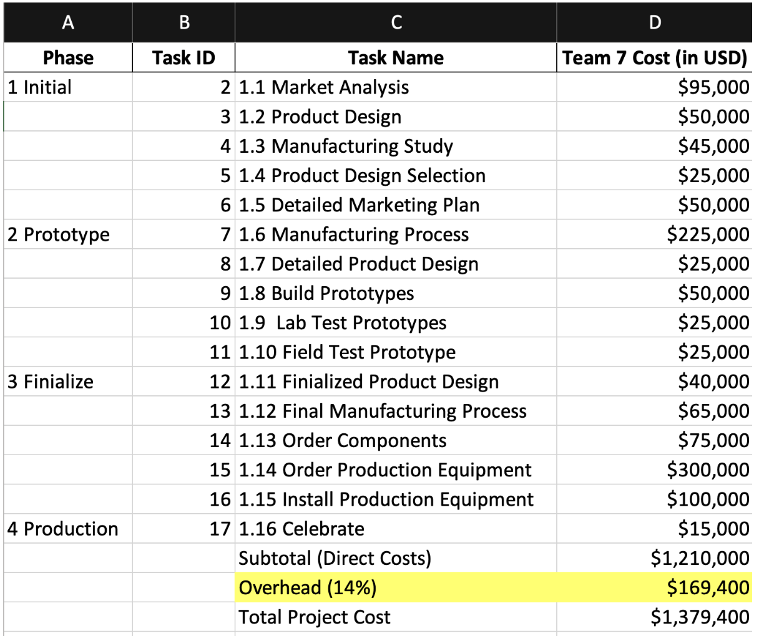
Project Cost

Slide 11
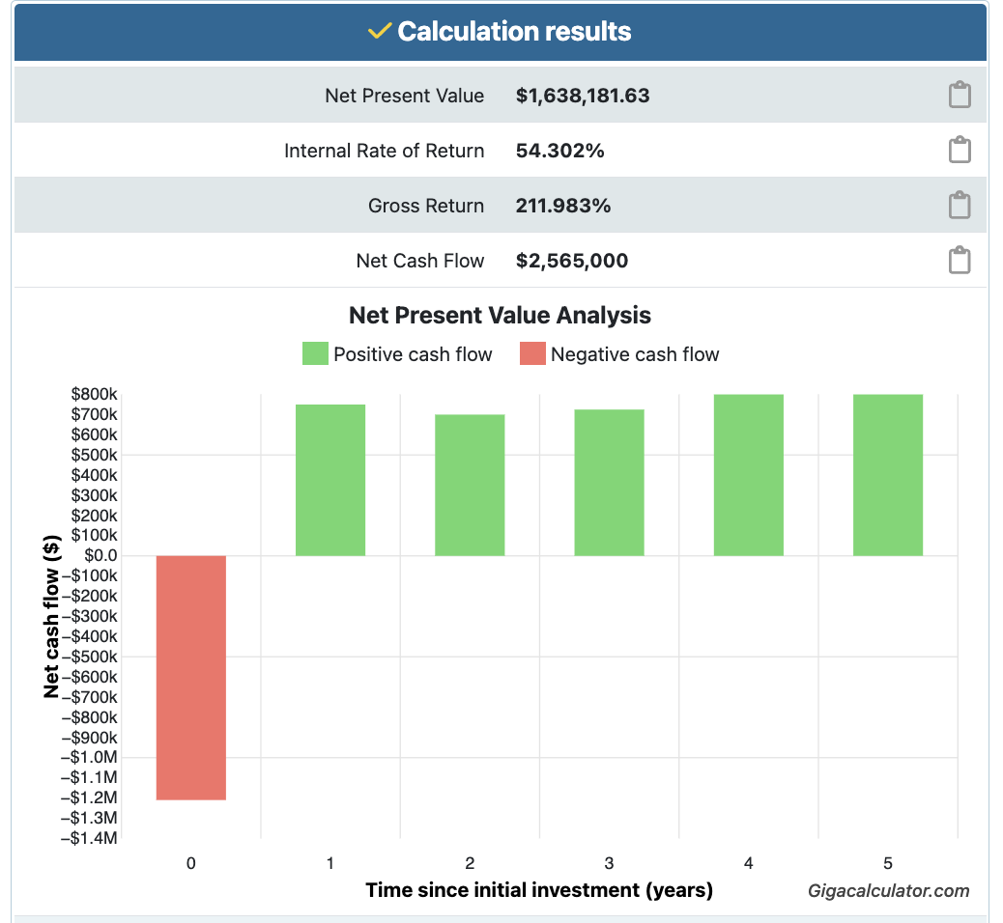
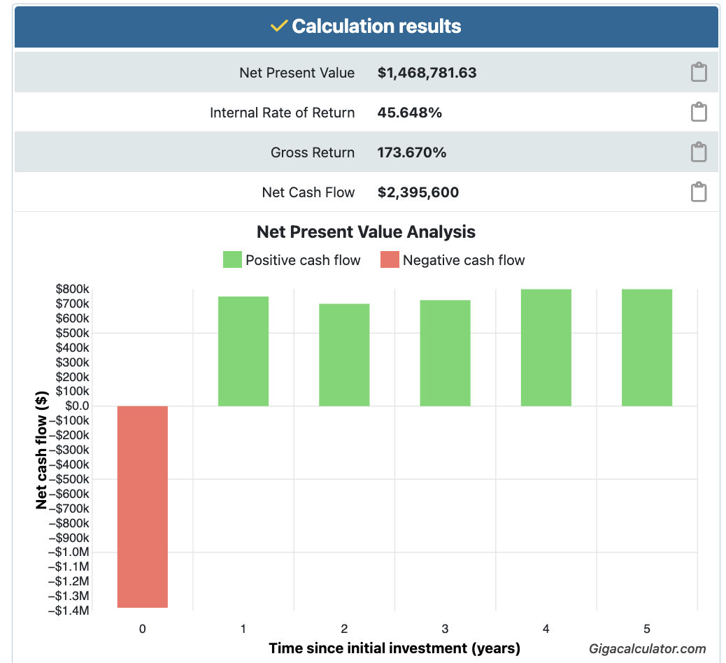
Net Present Value
NPV without Overhead
NPV With Overhead

Slide 12
NPV Summary
Detail | Without Overhead (USD) | With 14% Overhead (USD)
Initial Investment | $1,210,000 | $1,379,400
Discount Rate | 10% | 10%
Total 5-Year Inflows | $3,775,000 | $3,775,000
NPV | $1,638,182 | $1,468,782
The Net Present Value (NPV) analysis indicates that the Red Zuma Project is financially viable.
With an initial investment of $1.21M (without overhead), the project yields an NPV of $1.64M, and even after accounting for 14% overhead costs ($1.38M total investment), the NPV remains strong at $1.47M.
These results show that the project is likely to generate substantial positive cash flow, confirming its strategic worth and financial profitability.

Slide 13
Final Recommendations: Based on the given NPV
​ The Red Zuma Project is financially justified with a strong NPV under both scenarios:​
$1.64M (without overhead)​
$1.47M (with 14% overhead)​ ​
This confirms high return potential on investment.​
​ Strategically, the project strengthens ARC’s position in the racing scooter market, enhances brand visibility, and supports sustainable innovation goals.​ ​
Based on both financial and strategic value, we recommend proceeding with the project.

Slide 14
Non Financial Factors
B2B market scenarios
Cloud-based opportunities
Develop winning strategies to keep ahead of the competition​
Capitalize on low-hanging fruit to identify a ballpark value​
Visualize customer directed convergence
Iterative approaches to corporate strategy
Establish a management framework from the inside

Slide 15
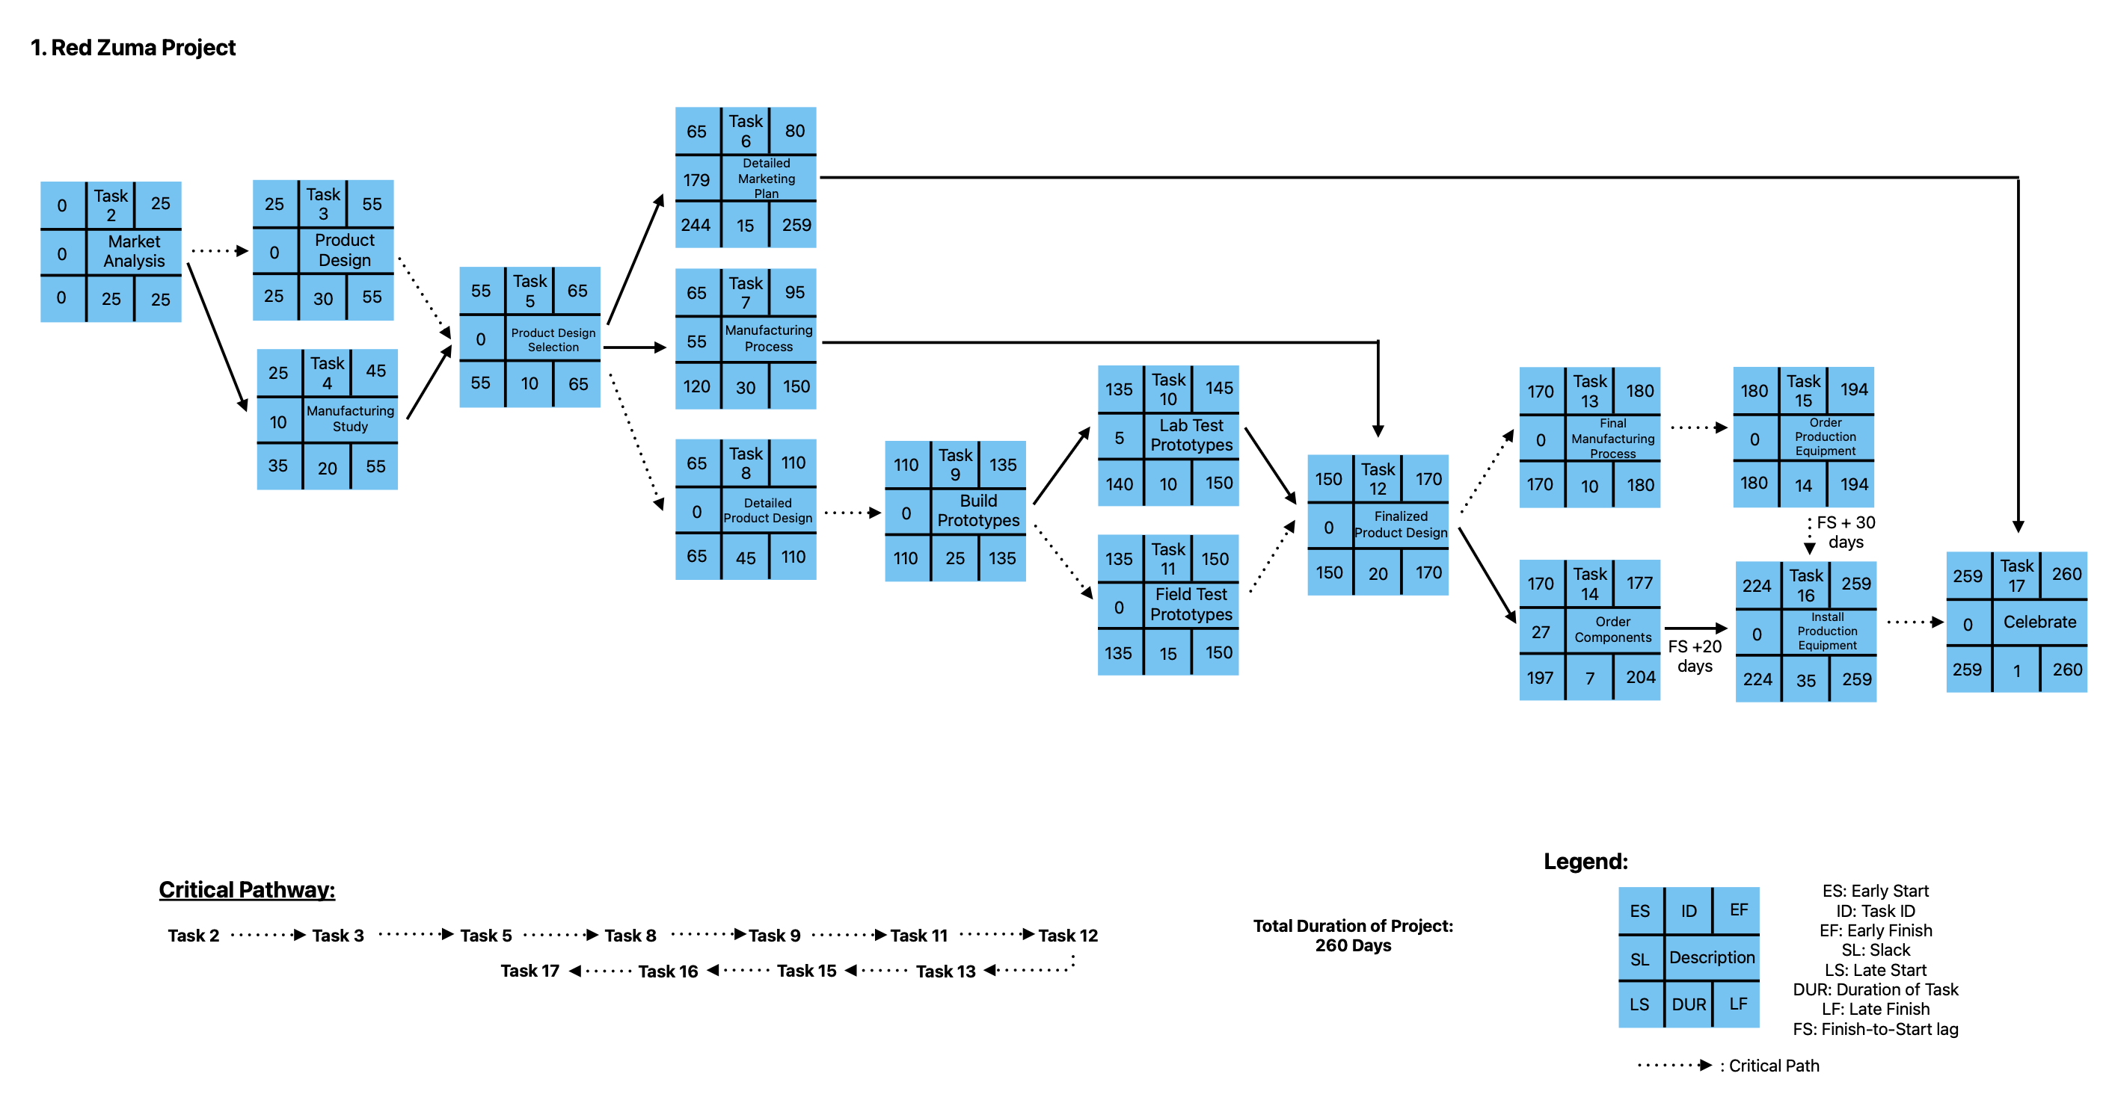
Activity on Node (AON)

Slide 16
Project Schedule
To Start By: Jan 2nd, 2015
To End By: Jan 17th, 2016
WBS Task ID | Task Name | Start Date | Finish Date | Late Start Date | Late Finish Date | Slack
2 | 1.1 Market Analysis | Jan 2, 2015 | Feb 6, 2015 | Jan 2, 2015 | Feb 6, 2015 | 0
3 | 1.2 Product Design | Feb 9, 2015 | Mar 23, 2015 | Feb 9, 2015 | Mar 23, 2015 | 0
4 | 1.3 Manufacturing Study | Feb 9, 2015 | Mar 9, 2015 | Feb 23, 2015 | Mar 23, 2015 | 10
5 | 1.4 Product Design Selection | Mar 24, 2015 | Apr 6, 2015 | Mar 24, 2015 | Apr 6, 2015 | 0
6 | 1.5 Detailed Marketing Plan | Apr 7, 2015 | Apr 27, 2015 | Dec 21, 2015 | Jan 13, 2016 | 179
7 | 1.6 Manufacturing Process | Apr 7, 2015 | May 18, 2015 | Jun 23, 2015 | Aug 5, 2015 | 55
8 | 1.7 Detailed Product Design | Apr 7, 2015 | Jun 9, 2015 | Apr 7, 2015 | Jun 9, 2015 | 0
9 | 1.8 Build Prototypes | Jun 10, 2015 | Jul 15, 2015 | Jun 10, 2015 | Jul 15, 2015 | 0
10 | 1.9 Lab Test Prototypes | Jul 16, 2015 | Jul 29, 2015 | Jul 22, 2015 | Aug 5, 2015 | 5
11 | 1.10 Field Test Prototype | Jul 16, 2015 | Aug 5, 2015 | Jul 16, 2015 | Aug 5, 2015 | 0
12 | 1.11 Finalized Product Design | Aug 6, 2015 | Sept 2, 2015 | Aug 6, 2015 | Sept 2, 2015 | 0
13 | 1.12 Final Manufacturing Process | Sept 3, 2015 | Sept 17, 2015 | Sept 3, 2015 | Sept 17, 2015 | 0
14 | 1.13 Order Components | Sept 3, 2015 | Sept 14, 2015 | Oct 13, 2015 | Oct 22, 2015 | 27
15 | 1.14 Order Production Equipment | Sept 18, 2015 | Oct 7, 2015 | Sept 18, 2015 | Oct 7, 2015 | 0
16 | 1.15 Install Production Equipment | Nov 23, 2015 | Jan 13, 2016 | Nov 23, 2015 | Jan 13, 2016 | 0
17 | 1.16 Celebrate | Jan 14, 2016 | Jan 14, 2016 | Jan 14, 2016 | Jan 14, 2016 | 0

Slide 17
KEY EVM CALCULATIONS
Metric | Formula | Value
Planned Value (PV) | Budgeted cost of the work scheduled | $533,172.76
Earned Value (EV) | Budgeted cost of the work performed | $451,315.52
Actual Cost (AC) | Actual cost of the work performed | $486,048.12
Cost Variance (CV) | EV − AC | –$34,732.60
Schedule Variance (SV) | EV − PV | –$81,857.24
Cost Performance Index (CPI) | EV ÷ AC | 0.93
Schedule Performance Index (SPI) | EV ÷ PV | 0.85

Slide 18
Interpretation of EVM Results
The Red Zuma Project is experiencing both cost and schedule setbacks. The project has a cost variance of –$34,732.60, meaning it is over budget, and a schedule variance of –$81,857.24, indicating it’s behind schedule.
The CPI is 0.93, reflecting only 93 cents of value per dollar spent, and the SPI is 0.85, showing that just 85% of the scheduled work has been completed.
Corrective measures are needed to regain control over both time and cost to meet the final January 17, 2016 deadline.

Slide 19
EVM Status Brief to Steering Committee
The Red Zuma Project is currently underperforming. While significant milestones like Product Design and Prototype Building have begun, the project is over budget by $34,732 and behind schedule by $81,857.
This is reflected in:
CPI: 0.93 → Cost efficiency is below expectations.
SPI: 0.85 → Progress is behind plan.
Recommended Actions:
Reassess task durations and resource allocation.
Evaluate current cost drivers and adjust scope or staff accordingly.
Fast-track or crash delayed activities where feasible.

Slide 20
Communication Plan
What Information | Target Audience | When? | Method of Communication | Provider
Project Status Report | Project Team, PM, Project Steering Committee | Weekly | E-mail and MS Teams update | Project Manager
Budget Status Update | CFO, CEO, Project Steering Committee | Monthly | E-mail and hardcopy summary | Finance Lead
Change Requests Log | PM, VP-Production Design, Project Team | As needed | Shared drive update & change form | Project Controls Coordinator
Risk Assessment Report | Project Manager, CEO, VP-Manufacturing | Bi-weekly | E-mail and issue log | Risk Manager
Market Research Report | CMO, Market Research Group, PM | Once every phase | Presentation & digital brief | Market Research Lead
Pilot Results Report | CEO, Project Steering Committee, VP-Design, Project Team | End of prototype stage | E-mail and formal meeting | Testing Lead
Critical Oversight Decisions | CEO, Project Steering Committee | As required | Meeting minutes and summary | Project Office

Slide 21
Risk Assessment Form
Risk Event | Likelihood | Impact | Detection Difficulty | When
Prototype build delay | 3 | 5 | 3 | During design phase
Equipment delivery delay | 2 | 5 | 4 | Pre-installation
Design rework | 4 | 4 | 3 | Post-prototype testing
Critical vendor contract breach | 2 | 5 | 3 | During procurement
Scope creep from stakeholders | 4 | 4 | 2 | During development
SCALE: 1 TO 5
1 | Negligible (minimal delay/cost)
2 | Minor (small cost or time impact)
3 | Moderate (causes some rework or 1-week delay)
4 | Major (delays a critical task or adds cost)
5 | Severe (threatens deadline, budget, or key deliverables)

Slide 22
Risk Response Matrix
Risk Event | Response | Contingency Plan | Trigger | Who Is Responsible
Prototype build delay | Mitigate: Add buffer time, monitor progress | Use weekend work if delayed | If build more than 5 days behind | Design Lead
Equipment delivery delay | Transfer: Early vendor confirmation; use backup suppliers | Expedite shipping if delayed | Vendor delays beyond agreed date | Purchasing Agent
Design rework | Mitigate: Early reviews and feedback loops | Extend testing team availability | Major flaws found in test results | Product Manager
Critical Vendor contract breach | Escalate: To the legal team and executive leadership for resolution | Switch to backup vendor, initiate contract penalties, escalate sourcing via emergency procurement | Vendor misses critical delivery milestone by more than 10 days | Purchasing Agent / Legal Team
Scope creep from stakeholders | Avoid: Enforce change control policy; conduct impact assessment | Defer changes to post- launch cycle | Any features requests post prototype approval | Project Manager

Slide 23
Summary
The goal of the Red Zuma project is to develop fast racing scooters in 260 days, with a start date of January 2, 2015 and an estimated finish date of January 14, 2016.
These scooters are intended to be launched in time for the X-Games held in Las Vegas.
The estimated total cost of the project is $1,379,400 USD.
According to our NPV & EVM calculations, this is a profitable project and should be funded and continued.

Slide 24
Thank you

